Slide 1
CI/CD Pipeline Automation with Integrated SAST, DAST, and SCA
CSA5803 - DEVSECOPS ENGINEERING AND APPLICATION SECURITY
Guided by, Dr. R. Pitchandi
Associate Professor
Department of Applied Machine Learning
SIMATS Engineering
Presented by, Y Guru Charan(192565020)
M Gokul(192565067)
T Harish (192521373)

Slide 2
Abstract
This study presents an automated CI/CD pipeline framework integrated with Static Application Security Testing (SAST), Dynamic Application Security Testing (DAST), and Software Composition Analysis (SCA) to strengthen software security across the entire development lifecycle. The proposed system simulates real-world development environments by incorporating continuous integration, automated testing, and deployment stages along with built-in security checks at each phase. A synthetic dataset and controlled pipeline scenarios were used to evaluate the effectiveness of the integrated security mechanisms in identifying vulnerabilities in both source code and runtime applications. The framework was designed, implemented, and tested under multiple conditions to ensure consistent performance and reliability. Comparative analysis with traditional CI/CD pipelines showed significant improvements in early vulnerability detection, reduced security risks, and enhanced deployment stability. Visualization techniques were applied to interpret pipeline performance, detection accuracy, and overall system efficiency. The results demonstrate that integrating SAST, DAST, and SCA within CI/CD pipelines enables proactive security enforcement, supports secure coding practices, and minimizes potential threats before production deployment.

Slide 3
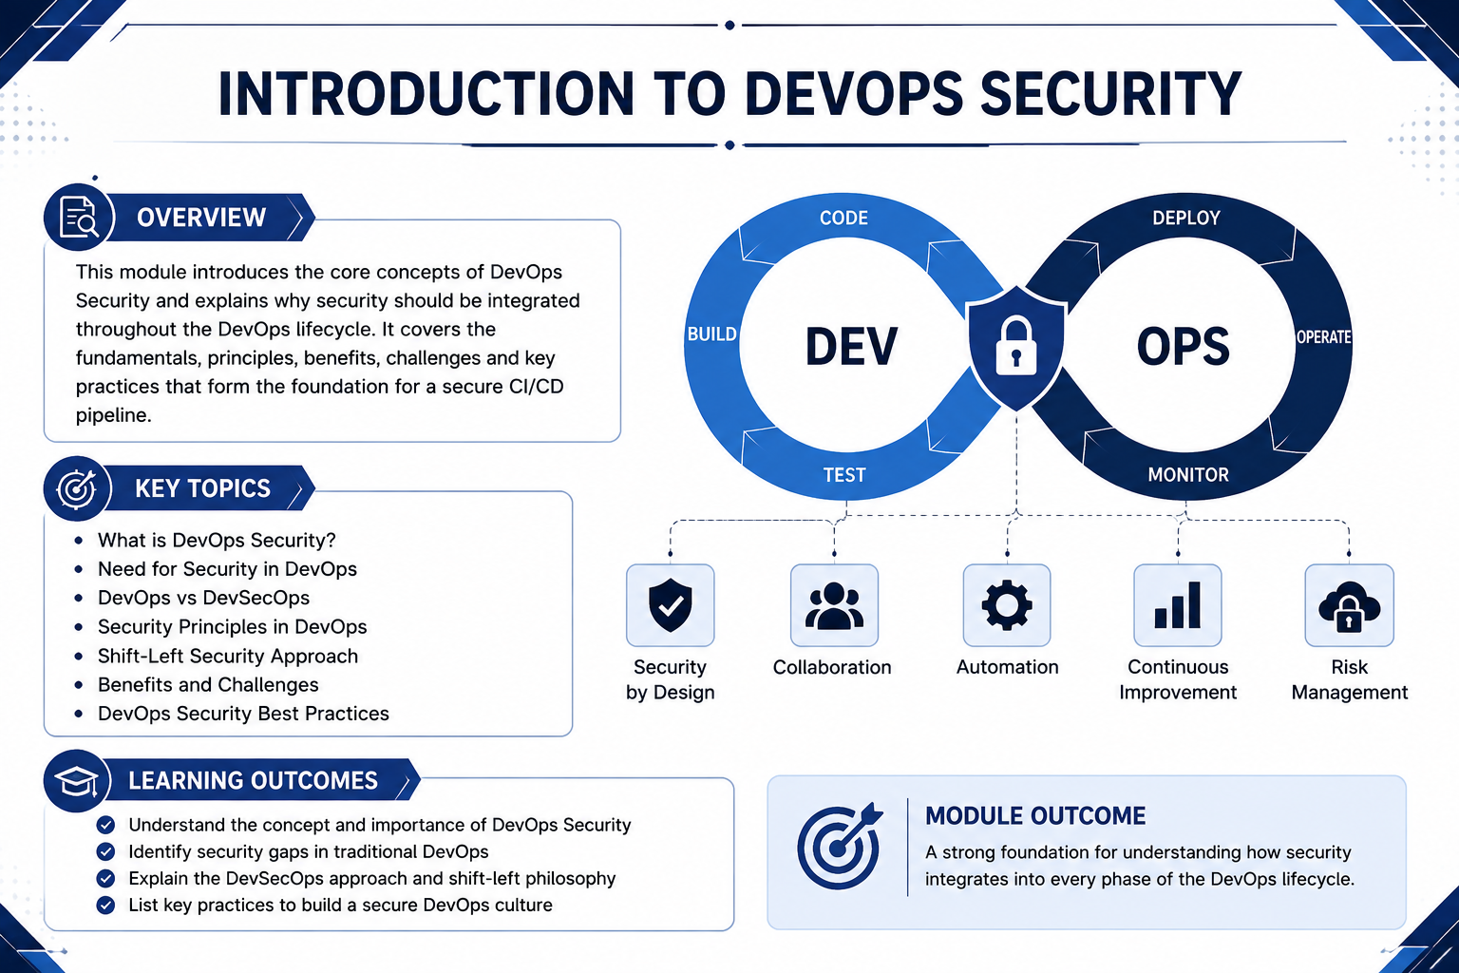
Introduction
Traditional CI/CD pipelines focus mainly on speed and efficiency but often lack integrated security measures.
Increasing cyber threats and vulnerabilities in software systems demand the integration of security within the development lifecycle (DevSecOps).
SAST (Static Application Security Testing) helps identify vulnerabilities in source code during the development phase.
DAST (Dynamic Application Security Testing) detects security issues in running applications during runtime.

Slide 4
Literature Survey
Author(s), Year, Journal/Proceedings | Title | Key Findings
Behl, A., 2017, IEEE Software | DevSecOps: Integrating Security into DevOps | Introduced the concept of integrating security practices into CI/CD pipelines, emphasizing early vulnerability detection and continuous monitoring throughout the software development lifecycle.
Rahman, M. & Williams, L., 2018, ACM Digital Library | Security Practices in Continuous Integration Environments | Analyzed security challenges in CI pipelines and highlighted the importance of automated static analysis (SAST) to detect vulnerabilities during the coding phase.
Sharma, T., 2019, International Journal of Computer Applications | Automated Security Testing in CI/CD Pipelines | Demonstrated how integrating automated testing tools improves detection rates of software vulnerabilities and reduces manual intervention
Kumar, R. & Singh, P., 2020, IEEE Access | Dynamic Application Security Testing in DevOps | Showed that DAST tools effectively identify runtime vulnerabilities and misconfigurations, enhancing application security during deployment stages.
Zhang, Q., 2021, Journal of Cybersecurity | Software Composition Analysis for Open Source Risk Management | Highlighted the importance of SCA in identifying vulnerabilities in third-party libraries and ensuring compliance with licensing policies.
Reddy, K. & Rao, V., 2023, International Conference on DevOps and Cloud Computing | Secure CI/CD Pipeline Automation using DevSecOps | Demonstrated that automation of security tools within CI/CD pipelines enhances deployment speed while maintaining strong security standards.

Slide 5
Research Gaps
High false positive rates in security tools reduce developer trust and slow down the pipeline.
Existing solutions do not adequately address security in microservices and cloud-native architectures.
Lack of real-time vulnerability prioritization mechanisms based on risk severity.
Existing CI/CD pipelines often integrate security tools, but lack full end-to-end automation across all stages.
Limited research on efficient integration of SAST, DAST, and SCA together in a unified pipeline framework.

Slide 6
Problem Statement
Modern software development relies heavily on CI/CD pipelines to achieve faster and continuous delivery of applications.
However, traditional CI/CD pipelines primarily focus on speed and automation, often neglecting integrated security practices.
The absence of continuous security testing increases the risk of introducing vulnerabilities into production environments.
Security tools like SAST, DAST, and SCA are often used independently, leading to fragmented security processes and inefficiencies.
Additionally, increasing use of third-party libraries and cloud-based deployments introduces new security risks and attack surfaces.

Slide 7
Objectives
To design and develop an automated CI/CD pipeline with integrated security mechanisms.
To incorporate SAST, DAST, and SCA tools for continuous security testing at different stages of the pipeline.
To enable early detection of vulnerabilities in source code, runtime applications, and third-party dependencies.
To reduce manual effort and human errors through automation of security processes.
To improve software quality, reliability, and deployment security.

Slide 8
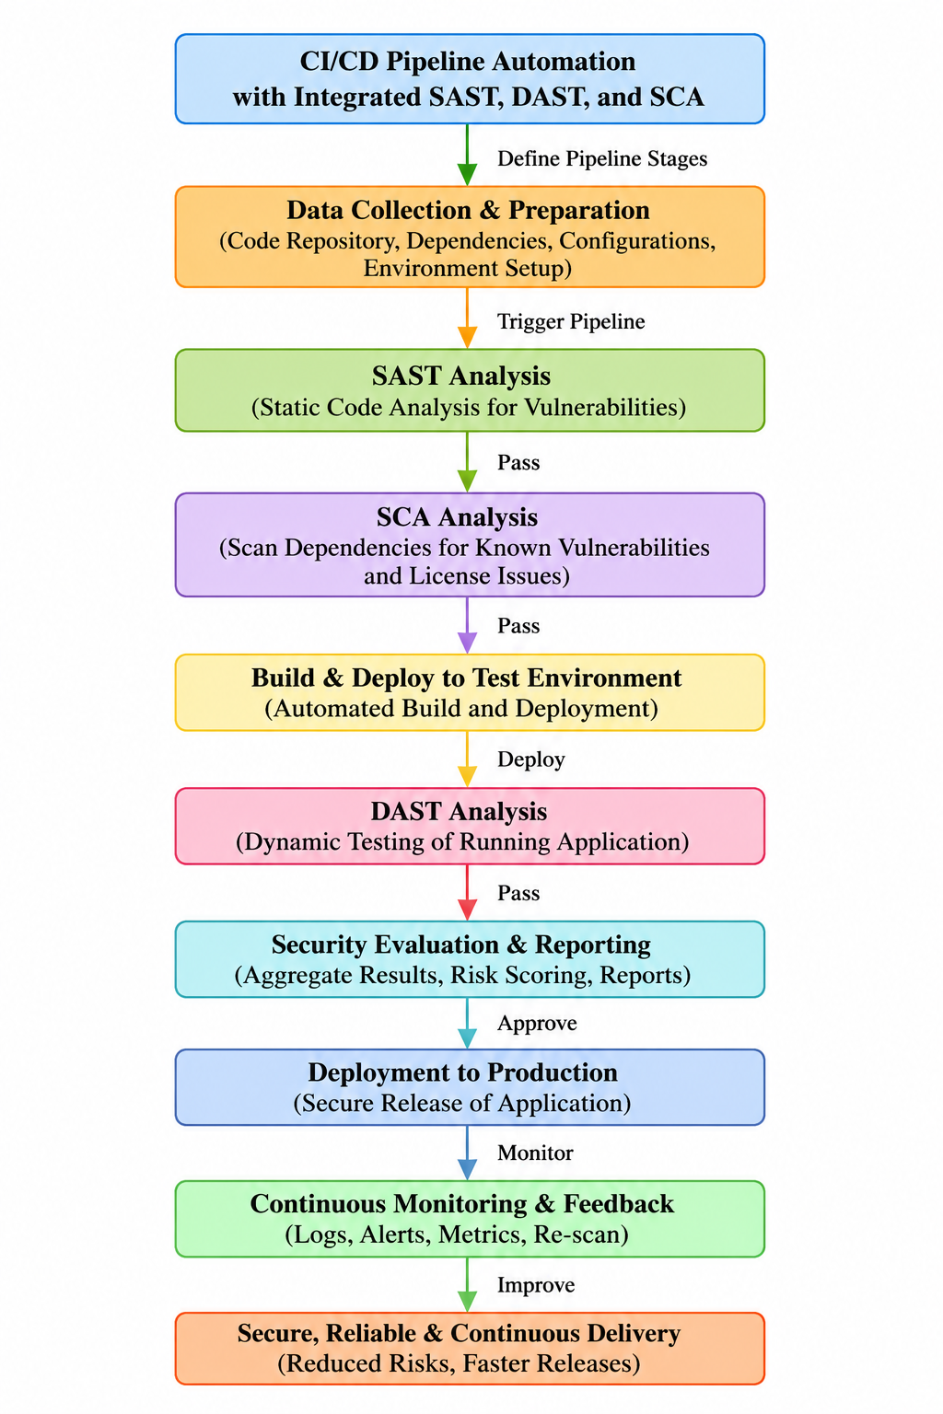
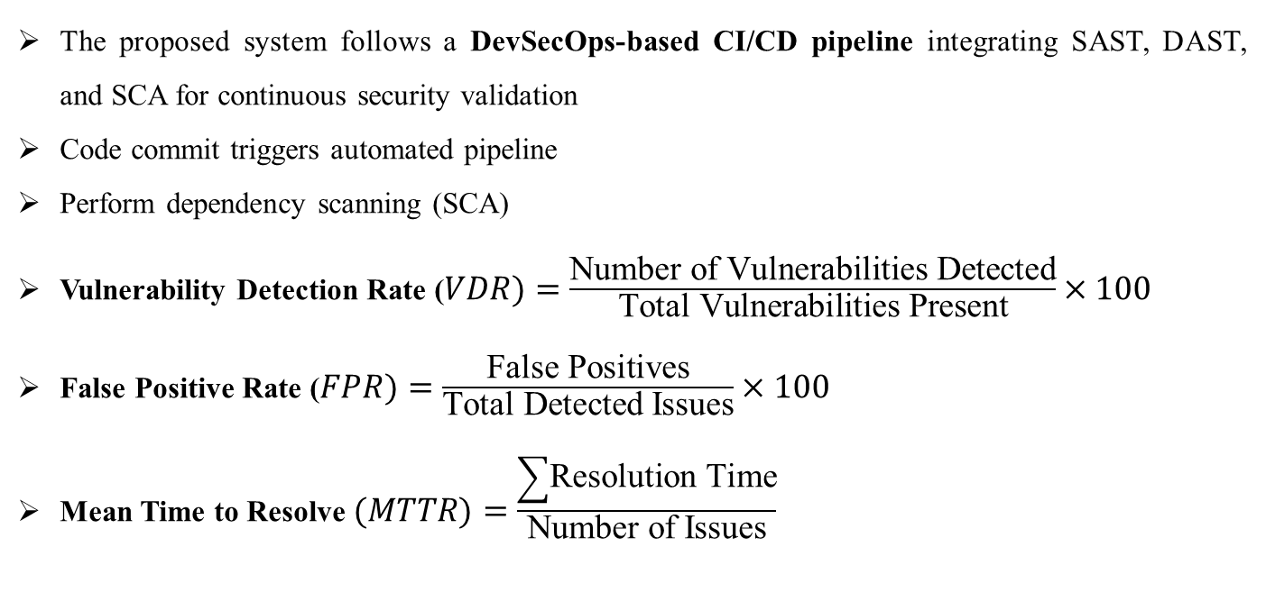
Methodology
The proposed system follows a DevSecOps-based CI/CD pipeline integrating SAST, DAST, and SCA for continuous security validation
Code commit triggers automated pipeline
Perform dependency scanning (SCA)
Vulnerability Detection Rate ($VDR)=\frac{\text{Number of Vulnerabilities Detected}}{\text{Total Vulnerabilities Present}}×100$
False Positive Rate ($FPR)=\frac{\text{False Positives}}{\text{Total Detected Issues}}×100$
Mean Time to Resolve $(MTTR)=\frac{\sum{\text{Resolution Time}}}{\text{Number of Issues}}$

Slide 9
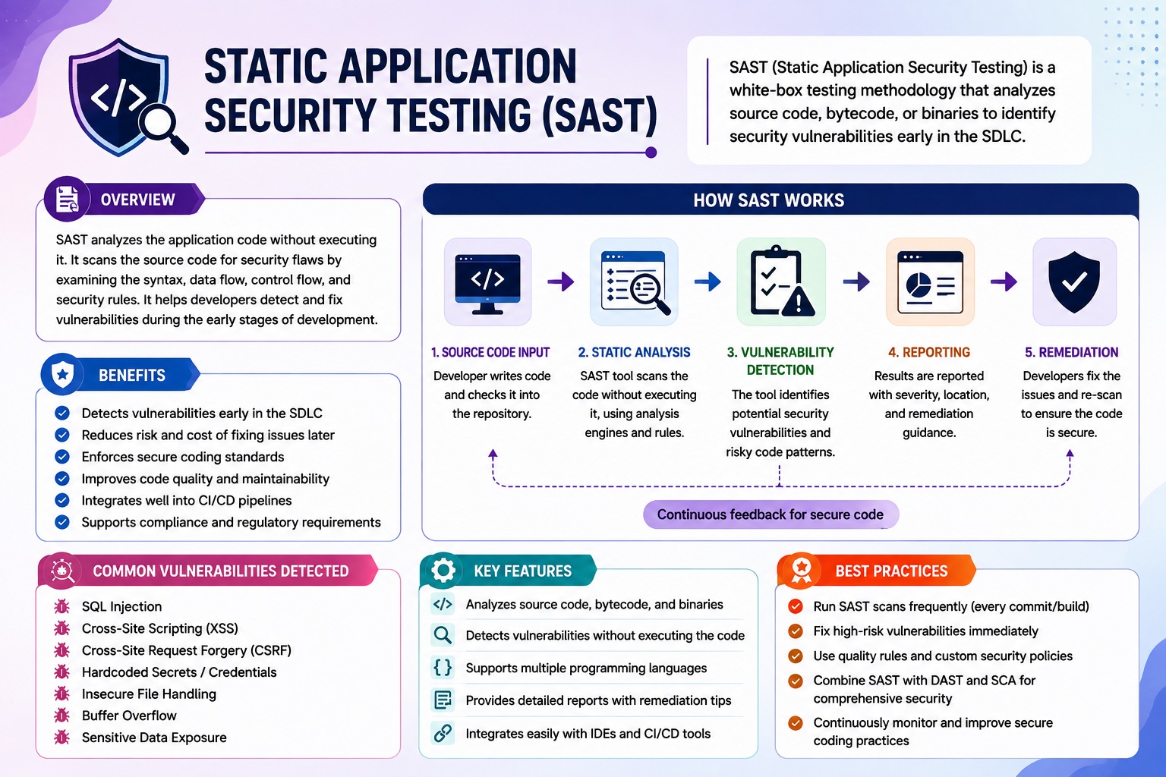
Module 1: Static Application Security Testing (SAST)
Analyzes source code at an early stage of the development lifecycle.
Performs static analysis without executing the application.
Identifies coding vulnerabilities such as insecure functions and logic flaws.
Detects issues like SQL injection, cross-site scripting (XSS), and buffer overflows.
Helps developers fix security issues before build and deployment.

Slide 10
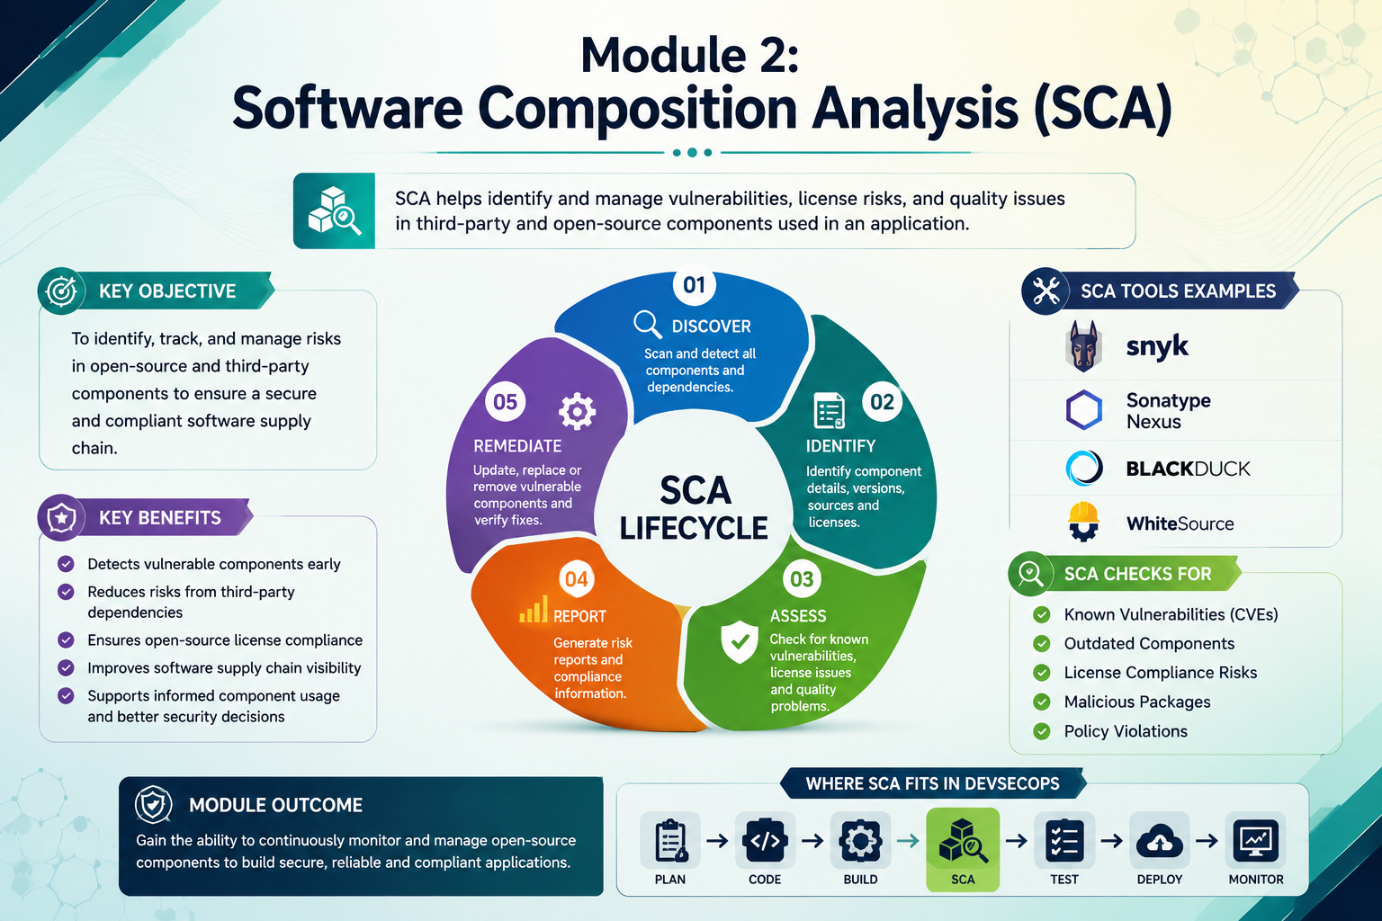
Module 2: Software Composition Analysis (SCA)
Identifies third-party libraries and open-source components used in the application
Detects known vulnerabilities in dependencies (e.g., outdated or insecure packages)
Monitors license compliance to avoid legal and usage issues
Provides real-time alerts for newly discovered vulnerabilities
Helps maintain an up-to-date and secure dependency ecosystem

Slide 11
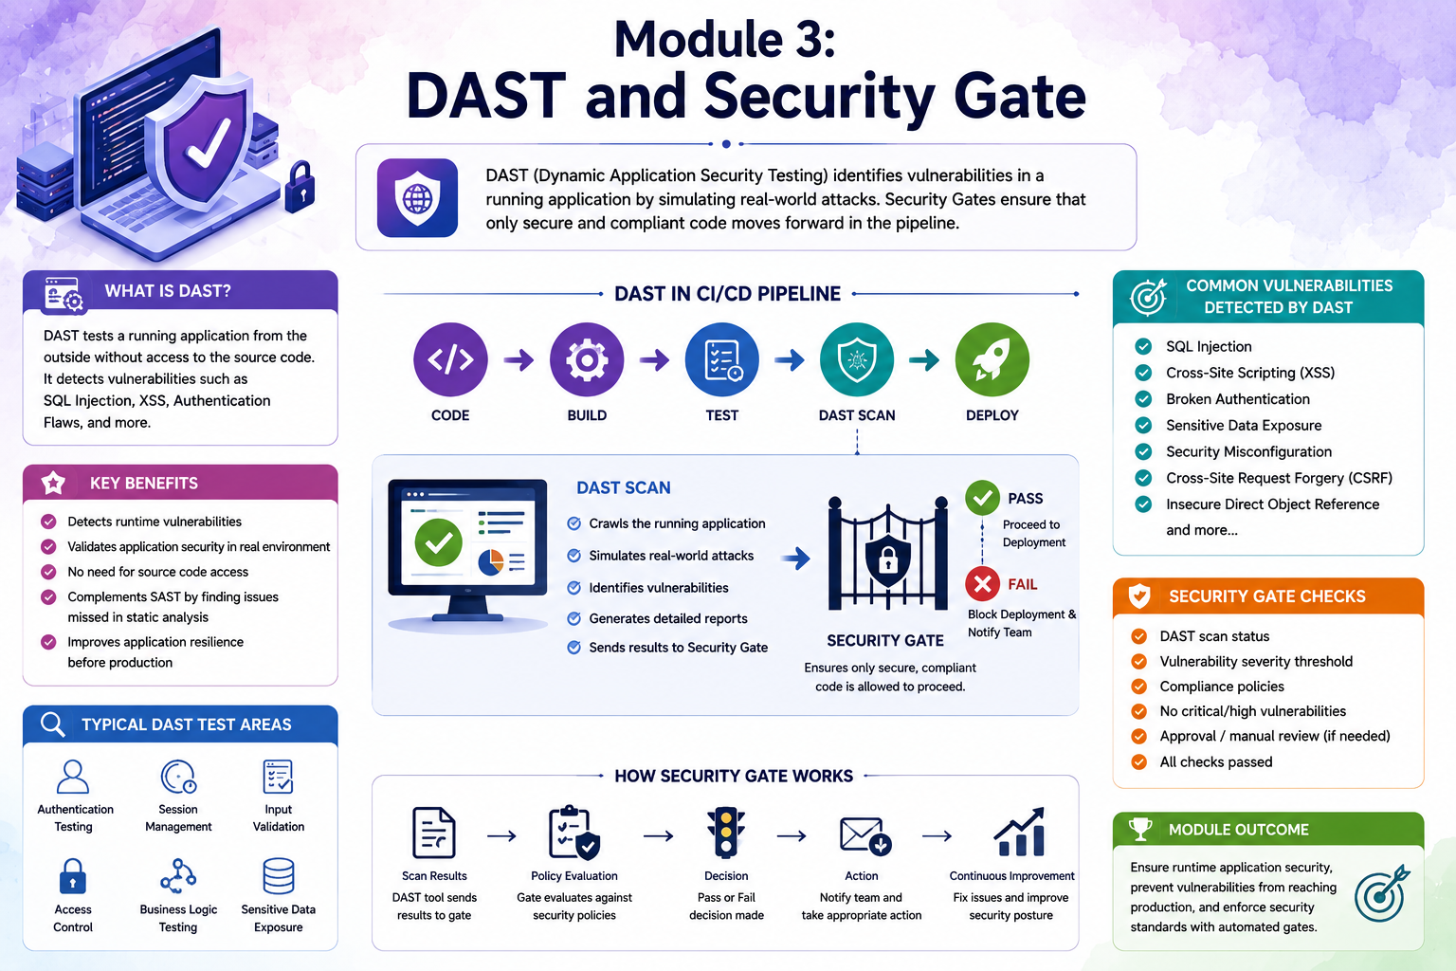
Module 3: DAST and Security Gate
Performs Dynamic Application Security Testing (DAST) on the running application
Detects runtime vulnerabilities such as SQL injection, XSS, and authentication issues
Simulates real-world attacks to identify security weaknesses
Analyzes APIs, user inputs, and server responses
Works in the testing/deployment phase of the CI/CD pipeline

Slide 12
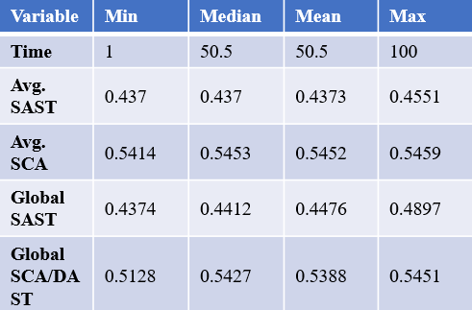
Discussion
This research explores the integration of security within CI/CD pipelines, emphasizing their interconnected nature through automated and continuous protection mechanisms.
Similar to how multiple security layers work together to reduce risks and improve system reliability, SAST (static analysis), DAST (dynamic testing), and SCA (dependency analysis) collaboratively enhance software security throughout the development lifecycle.
Common themes found in both Astrology and Astronomy
Data generated by the Hybrid ABM-SD model
Astrology | Astronomy | Equivalent Factors
Signs (Zodiac) | Constellations / Celestial Coordinates | Code Modules / Components in Repository
Planets | Celestial Bodies | Application Services / Microservices
Houses | Orbital Paths / Ecliptic Plane | Pipeline Stages(Build,Test,Deploy)
Planet Conjunctions | Orbital Alignments | Integration Of SAST,DAST,SCA tools
Dasha System | Orbital Periods | CI/CD Cycles (Build Frequency, Release Cycles)

Slide 13
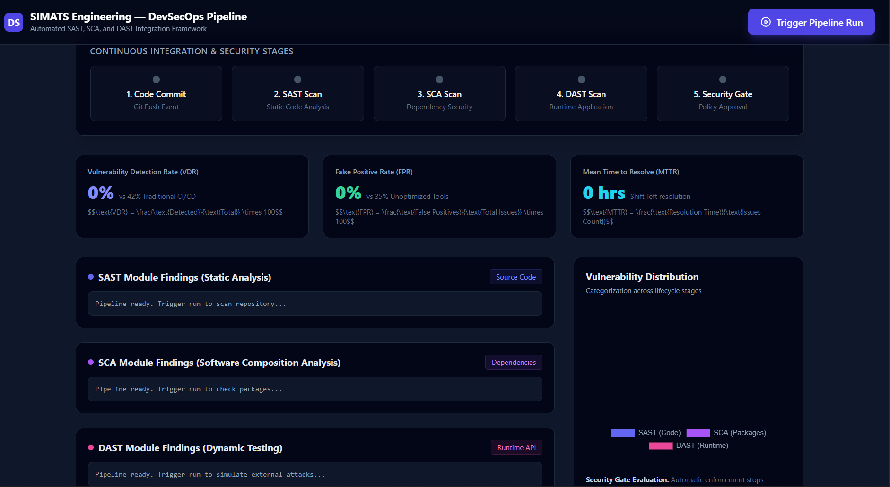
Results

Slide 14
Results
The system detected vulnerabilities using SAST, SCA, and DAST at different stages.
Early detection reduced security risks and errors.
Dependency issues were identified and fixed using SCA.
Runtime vulnerabilities were detected using DAST.
Overall, the pipeline showed improved security and efficiency.

Slide 15
Conclusion
The integration of SAST, SCA, and DAST strengthens overall pipeline security.
Early detection helps in reducing vulnerabilities and risks.
Automation improves efficiency and development speed.
The system ensures secure and reliable software deployment.
It provides a scalable and effective DevSecOps solution.

Slide 16
Future Scope
Integration of AI/ML techniques for intelligent and automated vulnerability detection.
Enhancement of real-time monitoring and predictive threat analysis.
Support for cloud-native and microservices architectures.
Improvement in reducing false positives and increasing detection accuracy.
Implementation of advanced security automation tools for fully autonomous DevSecOps pipelines.

Slide 17
References
Behl, A. (2017). DevSecOps: Integrating Security into DevOps. IEEE Software.
Rahman, M., & Williams, L. (2018). Security Practices in Continuous Integration Environments. ACM Digital Library.
Sharma, T. (2019). Automated Security Testing in CI/CD Pipelines. International Journal of Computer Applications (IJCA).
Kumar, R., & Singh, P. (2020). Dynamic Application Security Testing in DevOps. IEEE Access.
Zhang, Q. (2021). Software Composition Analysis for Open Source Risk Management. Journal of Cybersecurity.
Patel, S., & Mehta, D. (2022). Integrated Security Framework for CI/CD Pipelines. Springer Journal of Systems Engineering.
Reddy, K., & Rao, V. (2023). Secure CI/CD Pipeline Automation using DevSecOps. International Conference on DevOps and Cloud Computing.
Gupta, N. (2024). AI-Driven Security Testing in CI/CD Pipelines. IEEE International Conference on Emerging Technologies.

Slide 18
Acknowledgement
I would like to express my sincere gratitude to my guide for their constant guidance, valuable suggestions, and support throughout the project.
I am deeply thankful to all the faculty members of my department for their encouragement and academic support.
I extend my gratitude to my institution for providing the necessary infrastructure and learning environment.
I sincerely thank the authors and researchers whose work in the literature review helped shape this project.
I acknowledge the use of various online resources, tools, and documentation that supported the implementation of this project.
I appreciate the developers of open-source tools and platforms used in this study.
I am thankful for the constructive feedback received during the development phase, which improved the quality of this work.

Slide 19


